Slide 1
Transverse CPGE
Low-Frequency Peak
Group of: Prof. Guoqing Chang
Mohammad Yahyavi

Slide 2
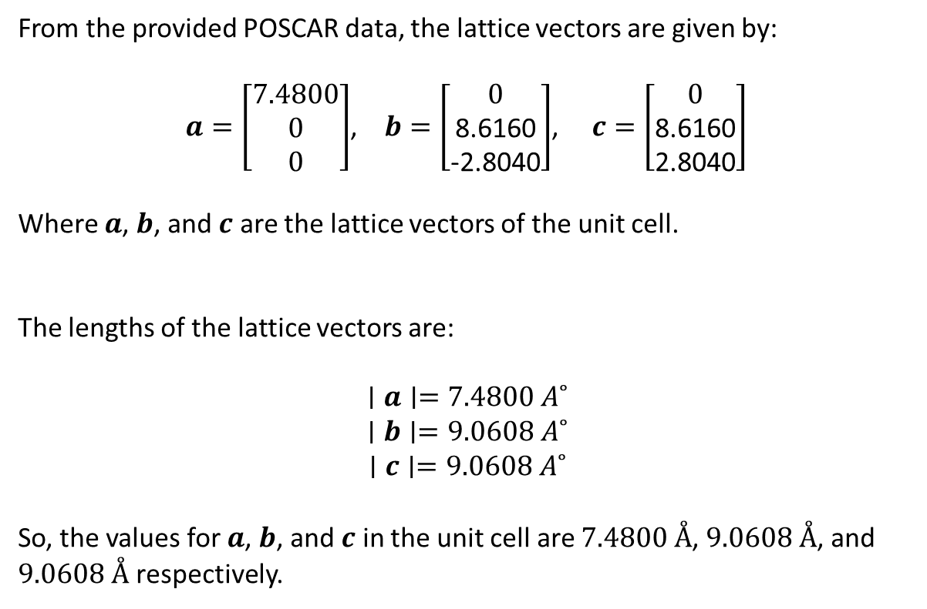
Original POSCAR
Primitive Cell
1.000000
7.4800 0 0
0 8.6160 -2.8040
0 8.6160 2.8040
S Ta
8 12
direct
0.8270000000 0.8476000000 0.0728000000
0.1730000000 0.9272000000 0.1524000000
0.8270000000 0.4272000000 0.6524000000
0.1730000000 0.3476000000 0.5728000000
0.5843000000 0.2692000000 0.5000000000
0.4157000000 0.5000000000 0.7308000000
0.5843000000 0.0000000000 0.2308000000
0.4157000000 0.7692000000 0.0000000000
0.7189600000 0.5895100000 0.0781100000
0.2810400000 0.9218900000 0.4104900000
0.7189600000 0.4218900000 0.9104900000
0.2810400000 0.0895100000 0.5781100000
0.1045500000 0.6546000000 0.1308000000
0.8954500000 0.8692000000 0.3454000000
0.1045500000 0.3692000000 0.8454000000
0.8954500000 0.1546000000 0.6308000000
0.6551000000 0.0263000000 0.4737000000
0.3449000000 0.5263000000 0.9737000000
0.9942000000 0.7609000000 0.7391000000
0.0058000000 0.2609000000 0.2391000000
From the provided POSCAR data, the lattice vectors are given by:
$a=\left[\begin{matrix}7.4800 \\ 0 \\ 0\end{matrix}\right]$, $b=\left[\begin{matrix}0 \\ \text{8.6160} \\ \text{−2.8040}\end{matrix}\right]$, $c=\left[\begin{matrix}0 \\ \text{8.6160} \\ \text{2.8040}\end{matrix}\right]$
Where $a$, $b$, and $c$ are the lattice vectors of the unit cell.
The lengths of the lattice vectors are:
$$∣a∣=7.4800 A˚$$
$$∣b∣=9.0608 A˚$$
$$∣c∣=9.0608 A˚$$
So, the values for $a$, $b$, and $c$ in the unit cell are $7.4800 Å$, $9.0608 Å$, and $9.0608 Å$ respectively.
2

Slide 3
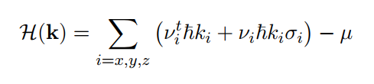
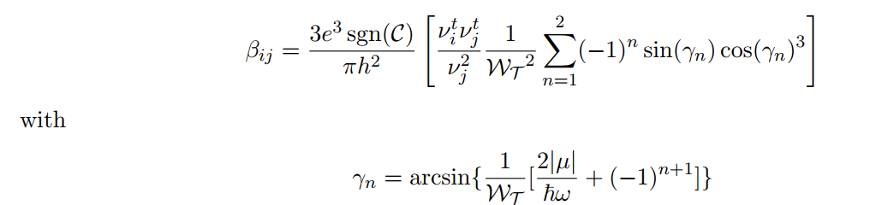
Effects of tilted velocity
The CPGE tensor for the tilted term in the Weyl Hamiltonian as follows
3

Slide 4


Model
The maximum value of $β_{ij}$ is profoundly affected by
$$\left\{\begin{matrix}\frac{{ ν}_{i}^{t}}{ν_{i}^{ }}=\frac{{ ν}_{j}^{t}}{ν_{j}^{ }} \\ \\ \frac{{ ν}_{k}^{t}}{ν_{k}^{ }}=0\end{matrix}\right.$$
Thus, we notice that under these conditions, the maximum value of $β_{ij}$ is given by:
$$β_{ij}=\frac{9\sqrt{3}e^{3}\operatorname{sgn}\left(C\right)}{32π^{2}h^{2}}\frac{{ ν}_{i}^{t}}{ν_{j}^{t}}$$
4

Slide 5


Model
The maximum value of $β_{xz}$ is profoundly affected by
$$\left\{\begin{matrix}\frac{{ ν}_{x}^{t}}{ν_{x}^{ }}=\frac{{ ν}_{y}^{t}}{ν_{y}^{ }} \\ \\ \frac{{ ν}_{z}^{t}}{ν_{z}^{ }}=0\end{matrix}\right.$$
Thus, we notice that under these conditions, the maximum value of $β_{xy}$ is given by:
$$β_{xy}=\frac{9\sqrt{3}e^{3}\operatorname{sgn}\left(C\right)}{32π^{2}h^{2}}\frac{{ ν}_{x}^{t}}{ν_{y}^{t}}$$
5

Slide 6
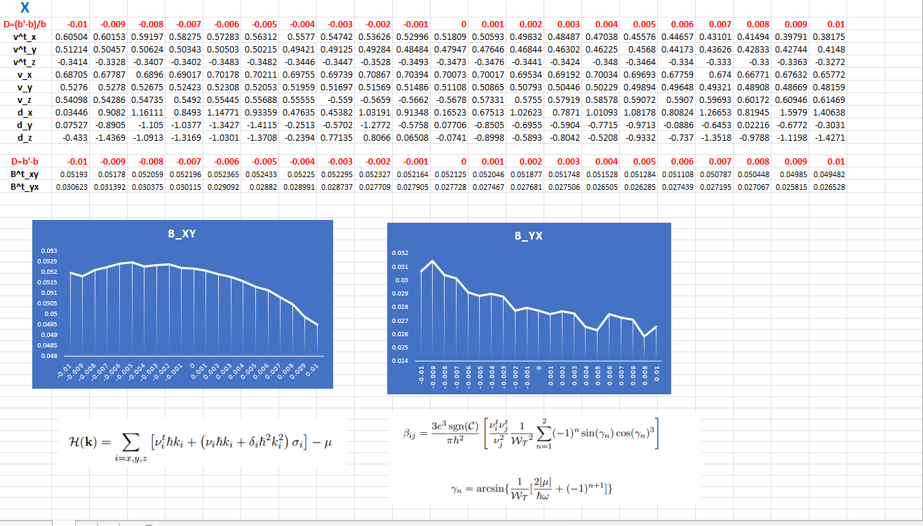

Slide 7
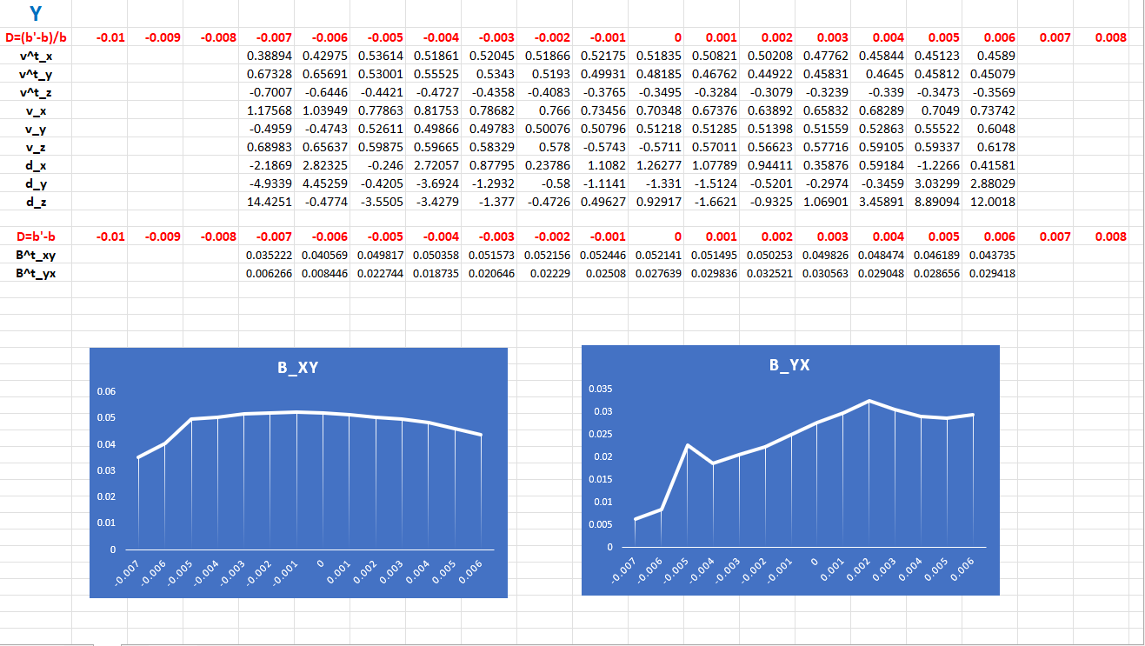

Slide 8
